Slide 1


Impact of Social Sciences, Humanities and Arts Conference
The Parallel Session on:
Quantitative and Qualitative Metrics for SSHA Impact on Society
13 October, 2021

Slide 2


Andrew Plume (Chair): President, International Center for the Study of Research (ICSR) & Senior Director of Research Evaluation, Elsevier
Walter Ysebaert: Responsible for ECOOM research domain: Evaluation of societal impact of research, Belgium
Kara Scally-Irvine: Board Member, Aotearoa New Zealand Evaluation Association
Impact of Social Sciences, Humanities and Arts
13-15 October, 2021
Overview of the Speakers
#SSHA21

Slide 3
Impact of Social Sciences, Humanities and Arts
13-15 October, 2021
Walter Ysebaert
Responsible for ECOOM research domain: Evaluation of societal impact of research, Belgium
#SSHA21

Slide 4


Evaluating SSHA impact on society
Walter Ysebaert
Co-promotor ECOOM VUB
Coordinator Data Office (Strategy and Policy Department), Vrije Universiteit Brussel
Faculty of Psychology and Educational Sciences, Vrije Universiteit Brussel

Slide 5

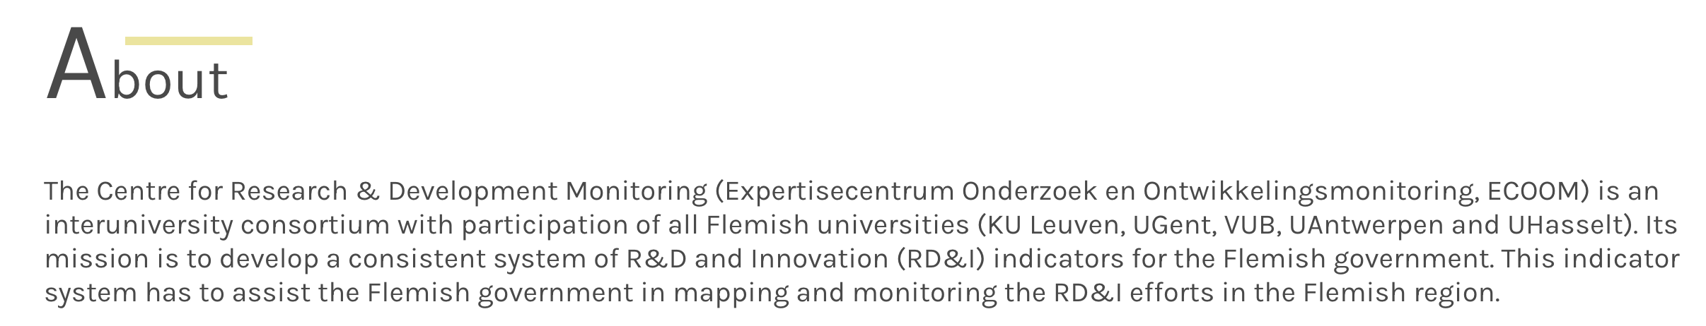
0. Background?
Ba in Community Work
PhD in Medieval History
Postdoctoral fellow at the Research Foundation Flanders
Lecturer Artesis University College
Policy advisor cabinet Minister of Economics, Science, Innovation
Vrije Universiteit Brussel
Co-promotor ECOOM

Slide 6
1. impact – what and why?
Focus on societal impact of university research
Two trends or debates that connect with each other
  societal transformations and expectations
  critical reflections (especially in SSH) on evaluation models and classic indicators
Changing HE and R&I landscape
Changing social context
Changing expectations towards universities (cf. also SDG’, Covid19) > where were the SSH in pandemic?
Changing perspectives (impact of research? institutional impact?...)

Slide 7
All this leads to the fact that there is an amalgam of definitions, concepts and models, and increasing theorizing, concept formation, …
  Lack of clarity regarding concepts and definitions
  Babylonian confusion (impact, societal impact, valorization, value, outreach, science communication, …)
  Danger of oversimplified indicators, models, lists and rankings
Scholarly debate with regard to societal impact and its integration in evaluation models:
Compensatory Perspective
Calibration Perspective
Integrity Perspective

Slide 8

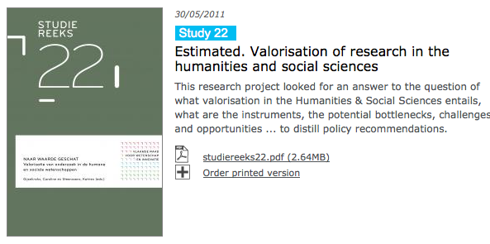
2. Impact – the Flemish case (I)
From ‘valorization’ to ‘impact’
VRWI, 2011 – valorization of research in SSH
Th&Ma, 2015 – valorization in Brussels universities

Slide 9
Valorisation of SSH research 'paradox of ubiquity and invisibility
Valorisation of research should be interpreted broadly. It is essential to recognize the various finalities it aims and the multiplicity it assumes:
  different finalities, or different possible multiple values ​​that can be created
  interactions with various possible social partners
  valorization can be done at different levels (project-related, in research programs and lines, in structurally anchored entities) and according to different types
The project showed that the importance of valorisation of research in the human and social sciences in the knowledge and innovation system was recognized or acknowledged to a limited extent.
  stimulating valorization policy is necessary
→ Five recommendations:
1. Broadly conceptualize valorisation 2. Operationalize and make valorization visible 3. Appreciate valorisation 4. Support valorisation 5. Giving space and support to collaboration

Slide 10
Survey 2014, Brussels HE institutions
Academic staff (N=727); 49% ZAP; 552% SSH

Slide 11
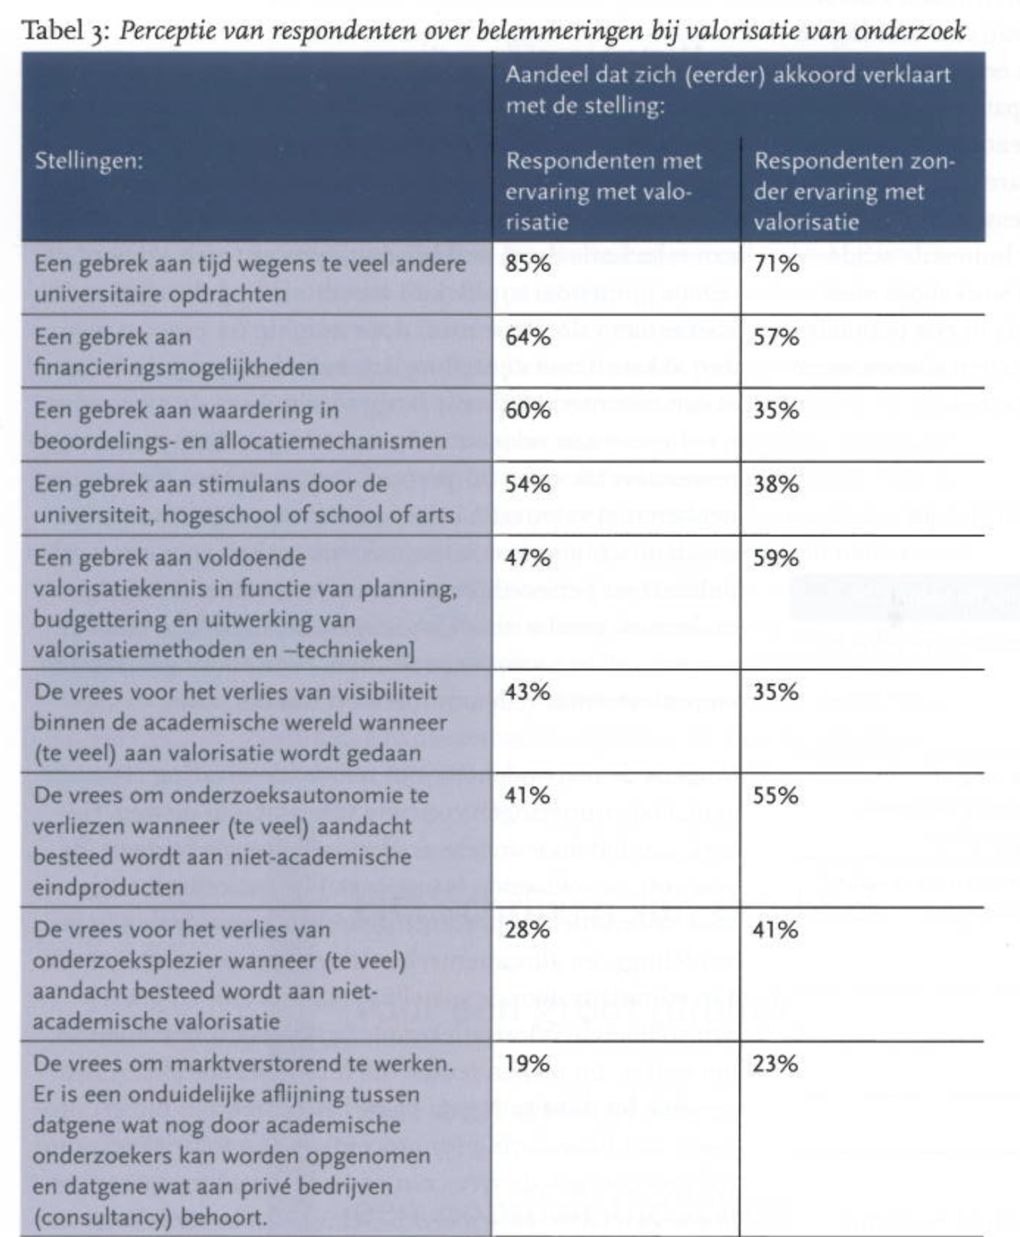
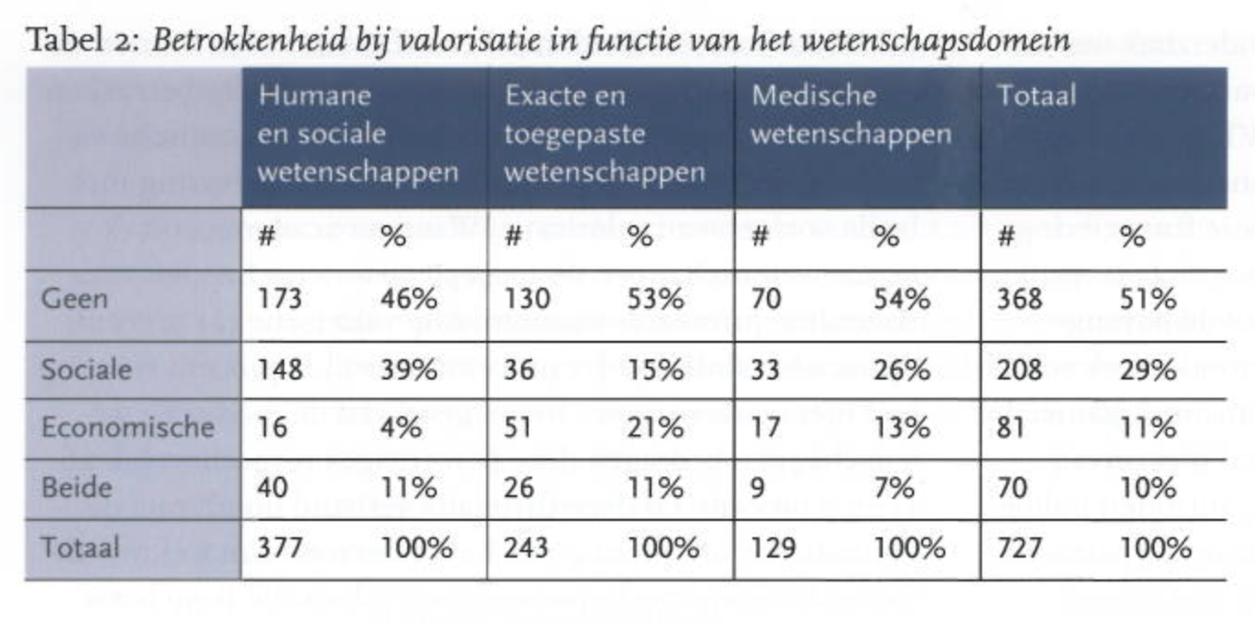
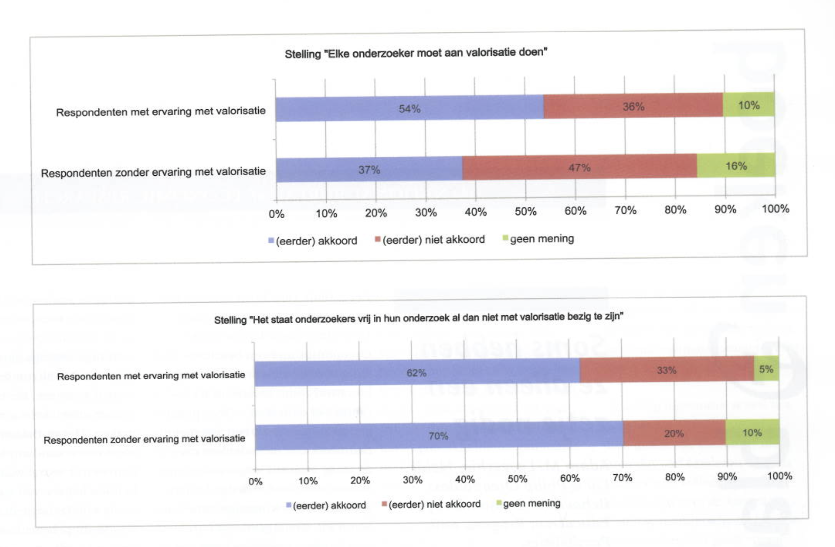

Slide 12
CORE FINDINGS?
Significant number of researchers engage in valorization
  Main valorization activities:
    Consultancy, training, development of commercial products
    Organisation/participation on conferences, publishing in non-academic media, advice
    ‘Social engagement’ (member of a board of a non-profit organisation, …)
  Very positive attitude towards valorization:
    Valorization is required: 46%
    Valorization should be considered: 65%
    Networking, personal enrichment, community involvement
  Public engagement very low
  Restrictions to address valorization:
    Time
    Lack of appropriate financing instruments
    No experience with regard to valorization possibilities
    Lack of appreciation in assessment and allocation mechanisms

Slide 13
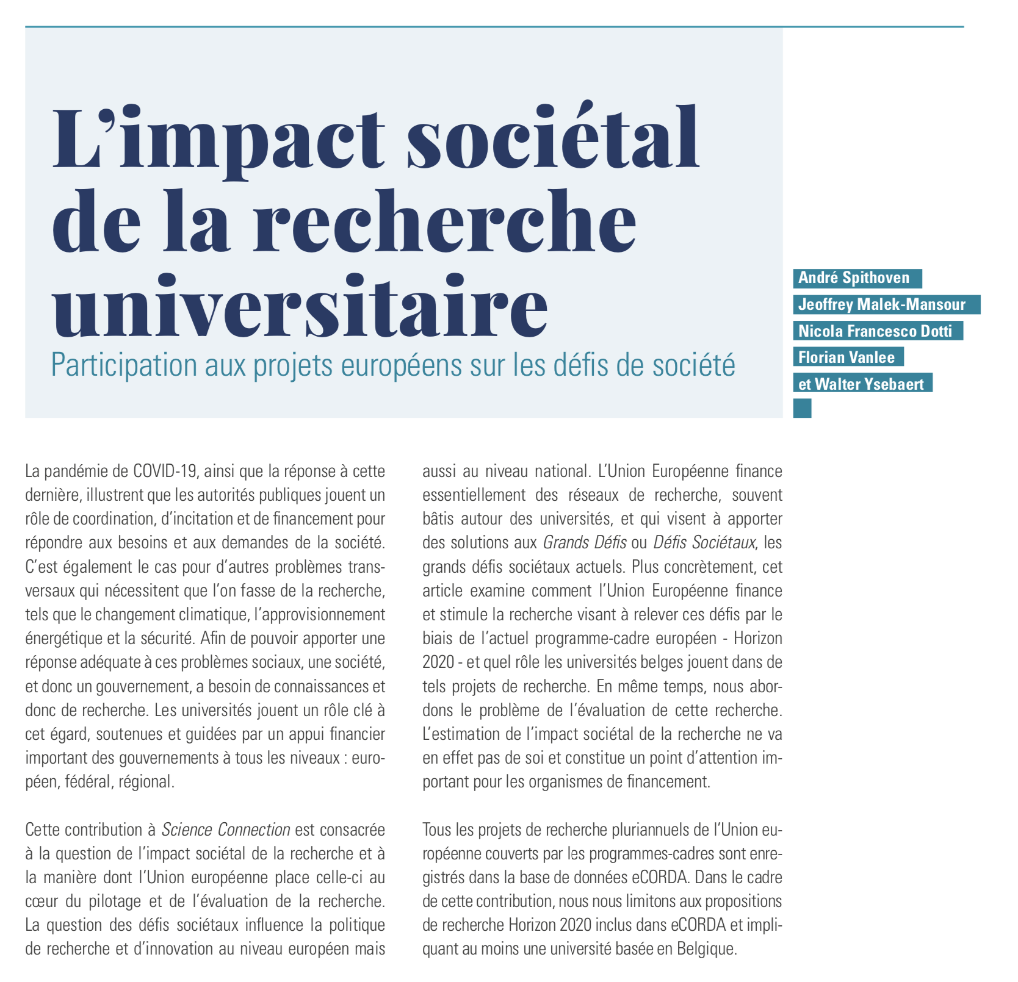
3. Measuring the societal impact of university research?
Profliferation of debates, proliferation of experiments, models, approaches… (see next slide)
Key elements associated with pursuing SIUR successfully (cf. e.g. Matt et al. 2017; Muhonen, Benneworth, and Olmos- Peñuela 2019)
  involvement of societal stakeholders
  interdisciplinary research
  longer term research perspectives
  non-academic dissemination of research findings
Danger of simplistic models and poor indicators (what? why? for whom?...) → detrimental effects on research/ers

Slide 14
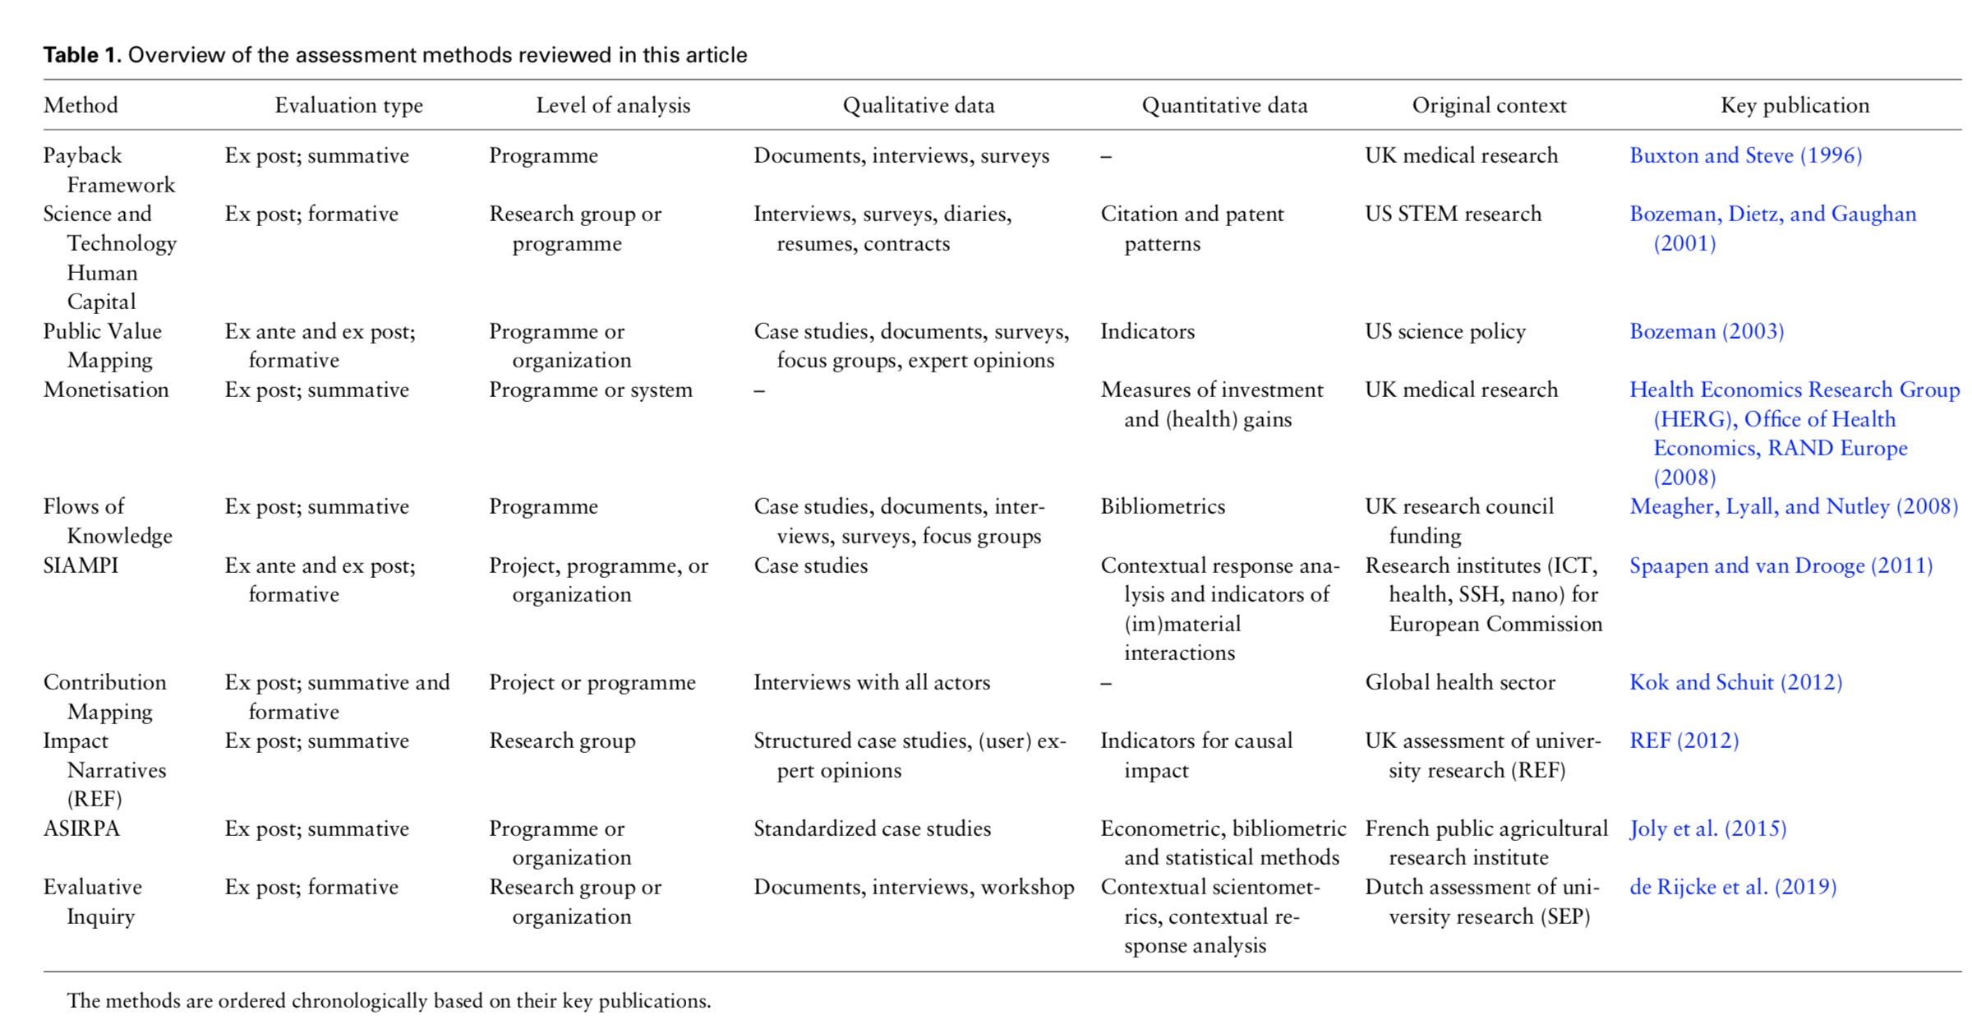
Overview of main methods and tools for the assessment of societal impact of university research
  see Smit, J.P. & Hessels, L.K., Research Evaluation, 2021
  see working note ECOOM, 2021
    Altmetrics
    Impact Pathways and
    Productive Interactions
    Hybrid Models

Slide 15
4. ECOOM – The Flmemish Case (II)
Flanders 2021-…?
No indicators/models for the evaluation of societal impact of university research yet (although valorization or ‘societal finality of research’ are considered, e.g. FWO-Vlaanderen)
ECOOM (2019-2023:
  Exploratory research
  Attribution and contribution
  Casestudies focusing on:
    (social) media mentionings (A)
    policy documents mentionings (A)
    registering productive interactions and pathways (C)
    involvements in SDG research (C)
    difference in disciplines; interdisciplinarity, …
    → new indicator? new model?

Slide 16
walter.ysebaert@vub.be
THANK YOU!

Slide 17



Slide 18
Impact of Social Sciences, Humanities and Arts
13-15 October, 2021
Kara Scally-Irvine
Board Member, Aotearoa New Zealand Evaluation Association
#SSHA21

Slide 19
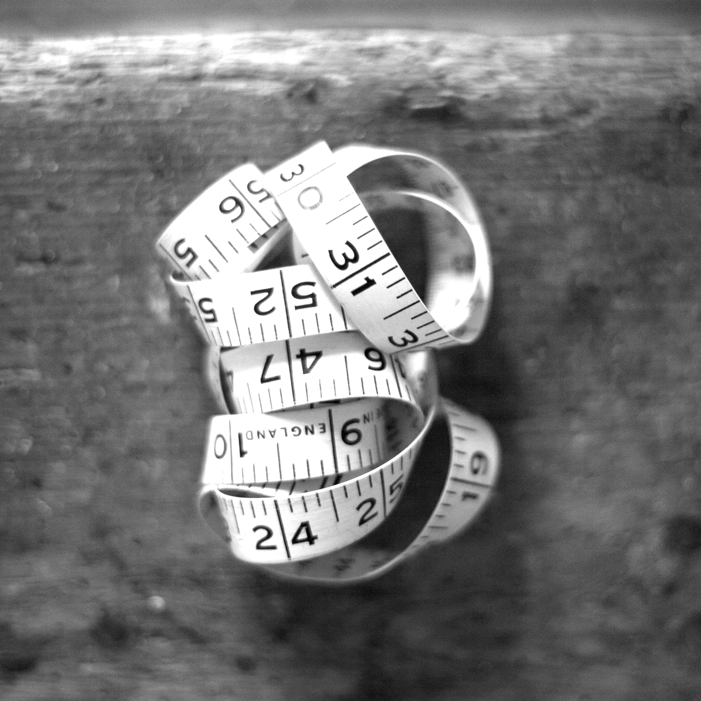


AESIS
IMPACT OF SOCIAL SCIENCE & HUMANITIES CONFERENCE 2021
Evaluating SSHA impact on society
13 October 2021
AUTHOR: Dr Kara Scally-Irvine

Slide 20
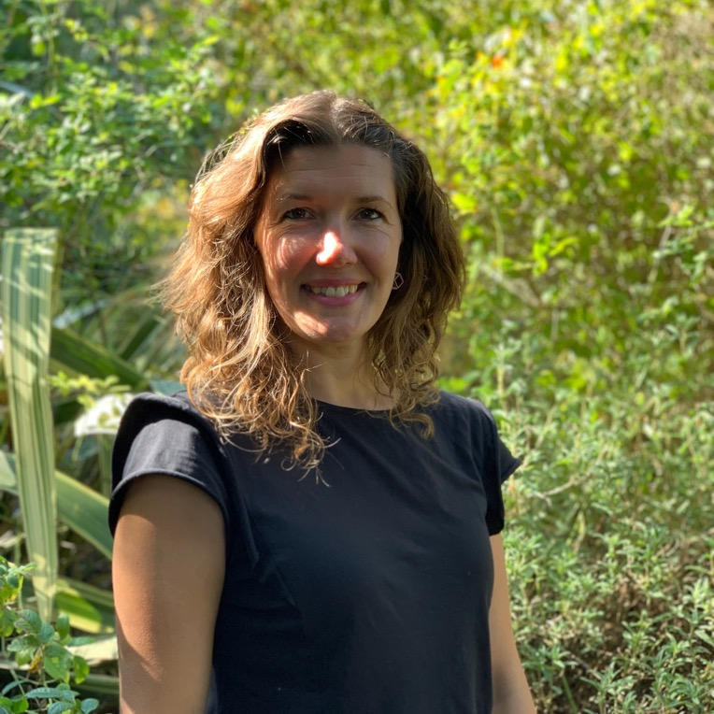


CONTEXT
About me
  Mixed background
    PhD in quantitative and qualitative research
  Working as an evaluator in New Zealand for 10 years
    Active member of the evaluation community (NZ and Australia)

Slide 21


I’m here because….
Which metrics exist to effectively demonstrate the impact of SSHA research,
and
what are the differences and challenges for choosing quantitative and/or qualitative measures
  I bring my evaluation lens to this.
  For me, answering this question is first thinking about….
  Context
  Values
  Questions
  Then evidence / data / indicators

Slide 22
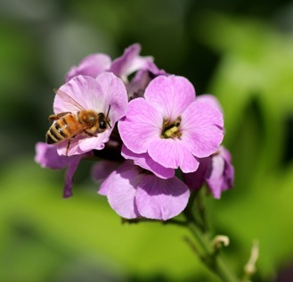



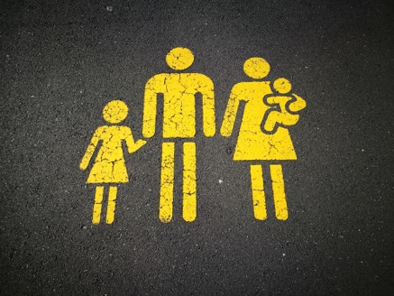
IMPACT
Fundamentally about values
  Values (and therefore impact) is a human construct
  What is considered important in this context?
  Who defined/determines what is important?
  How would we know, and what is considered legitimate and credible ‘evidence’ in that context?
  Whose voices or perspectives AREN’T captured / represented?

Slide 23
QUESTION
When you think about any SSHA Indicator or metric,
have you considered for WHOM the have been developed for?
Whose values do they reflect?
What might be missing?

Slide 24




Evidencing the impact of SSHA research in NZ

Slide 25
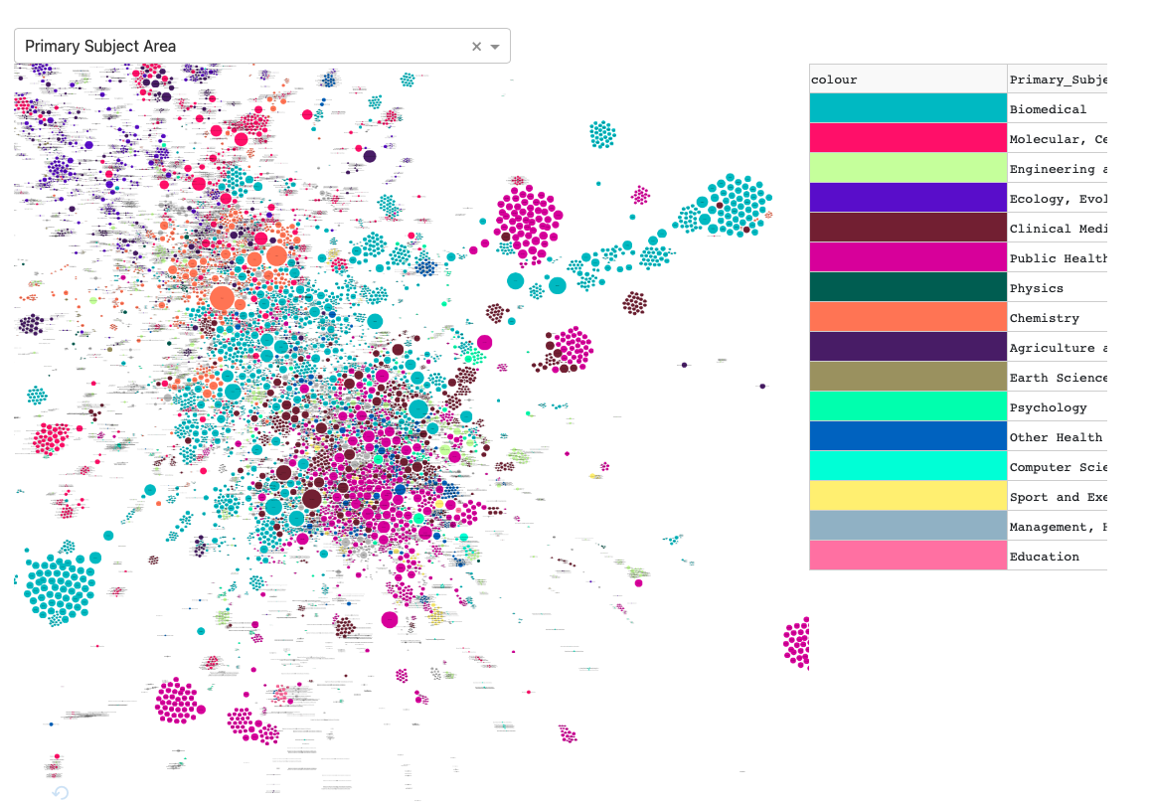
Evidencing the impact of SSHA research in NZ
Research collaboration

Slide 26
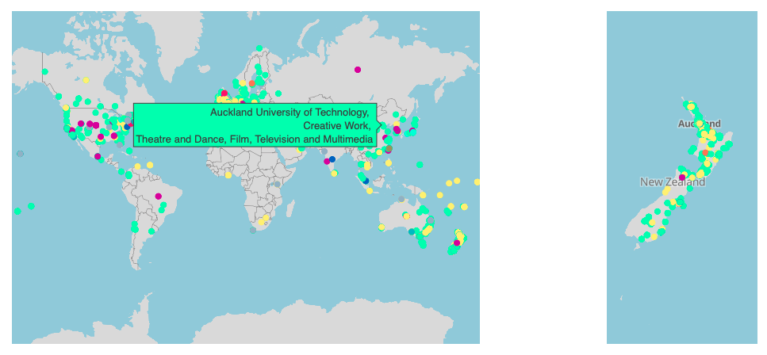
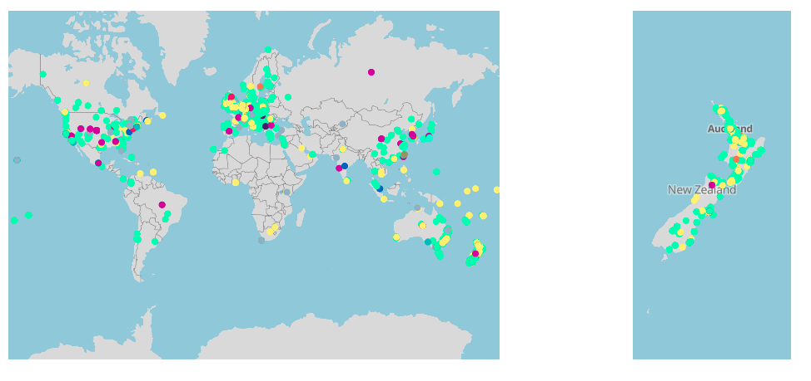
Evidencing the impact of SSHA research in NZ
Research dissemination
SO WHAT??

Slide 27

IMPACT - HOW DO YOU FRAME IT?
Makes a huge difference to what indicators will be relevant, meaningful, and appropriate

Slide 28
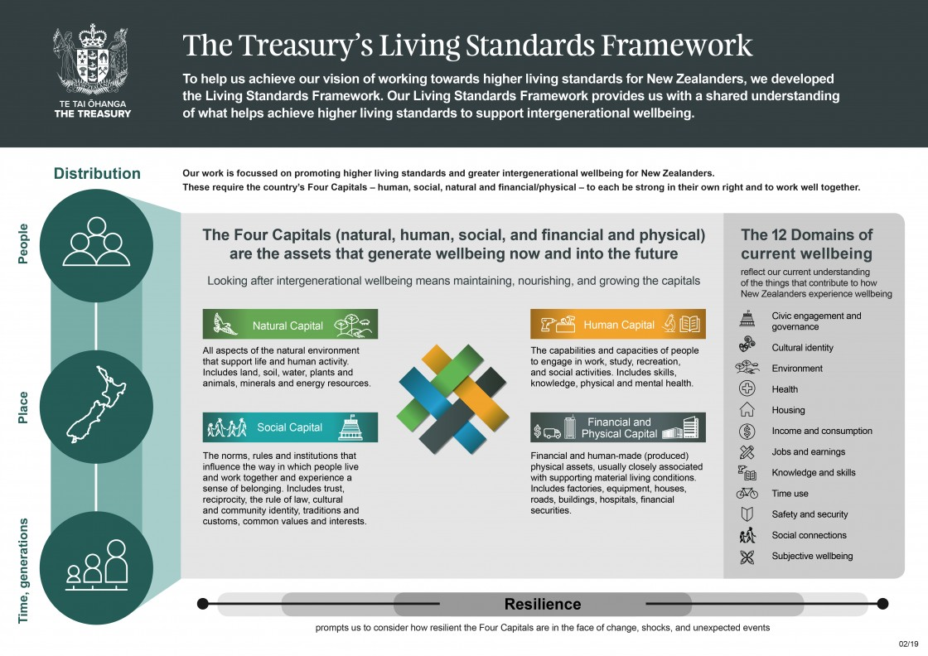
EXAMPLE - NZ
https://www.treasury.govt.nz/information-and-services/nz-economy/higher-living-standards/our-living-standards-framework

Slide 29
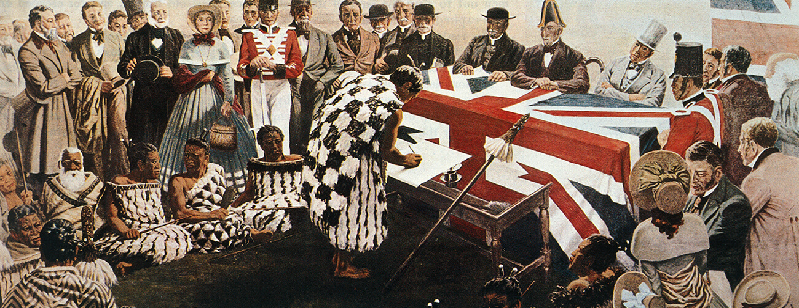
A Bi-cultural context
Te Tiriti Ō Waitangi | The Treaty of Waitangi
https://www.nzstory.govt.nz/stories/the-treaty-of-waitangi/

Slide 30
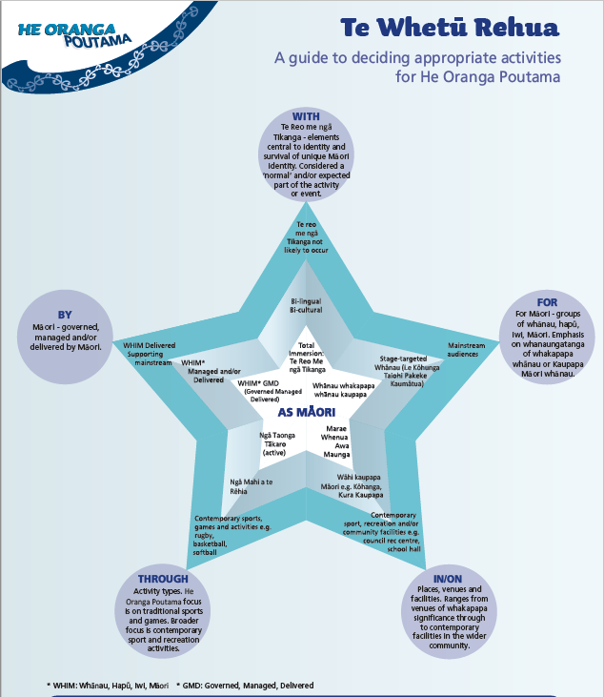
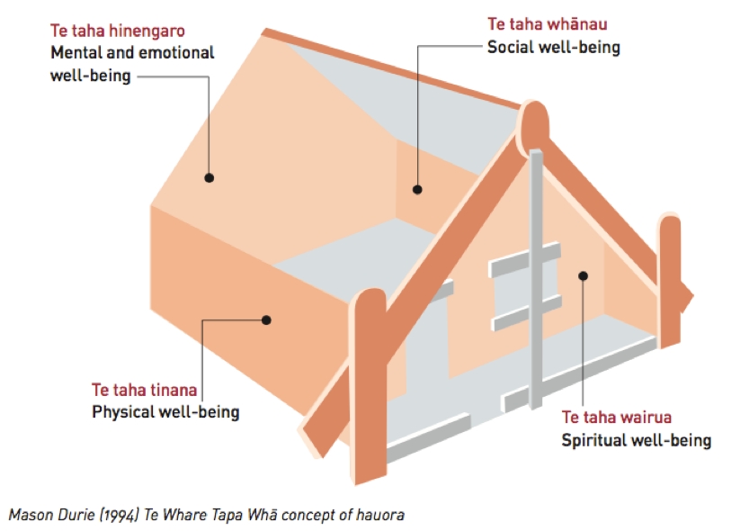
WELLBEING LOOKS AND IS UNDERSTOOD DIFFERENTLY
Te Whare Taka Wha
https://health.tki.org.nz/Teaching-in-Heath-and-Physical-Education-HPE/HPE-in-the-New-Zealand-curriculum/Health-and-PE-in-the-NZC-1999/Underlying-concepts/Well-being-hauora
Te Whetū Rehua
https://sportnz.org.nz/kaupapa-maori/e-tu-maori/te-whetu-rehua/
Continued colonization when ‘western’ frameworks are imposed or privileged

Slide 31
EXAMPLE – NZ from a different perspective
https://www.treasury.govt.nz/information-and-services/nz-economy/higher-living-standards/he-ara-waiora

Slide 32
Back to the original question!
Which metrics exist to effectively demonstrate the impact of SSHA research,
and
what are the differences and challenges for choosing quantitative and/or qualitative measures
Impact for whom?
What information (and therefore indicators) matters to them, and what or who might be missing?
Is that the more important first question?

Slide 33
Thank you
Questions & Discussion

Slide 34



EXAMPLE – systems thinking
Bob Williams, Ray Ison
  Understand INTER-RELATIONSHIPS
  Engaging with MULTIPLE PERSPECTIVES
  Reflect on BOUNDARIES

Slide 35
Impact of Social Sciences, Humanities and Arts
13-15 October, 2021
Thank you!
#SSHA21

